Slide 1
More on operators
Zainab Shahzadi

Slide 2
Assignment Statement
The assignment statement takes the form:
Expression is evaluated and its value is assigned to the variable on the left side
In C++, = is called the assignment operator

Slide 3
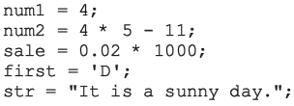
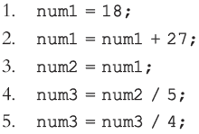
Assignment Statement (cont'd.)
Notes:
Sample Run:
num1 = 4
num2 = 9
sale = 20
first = D
str = It is a sunny day.

Slide 4
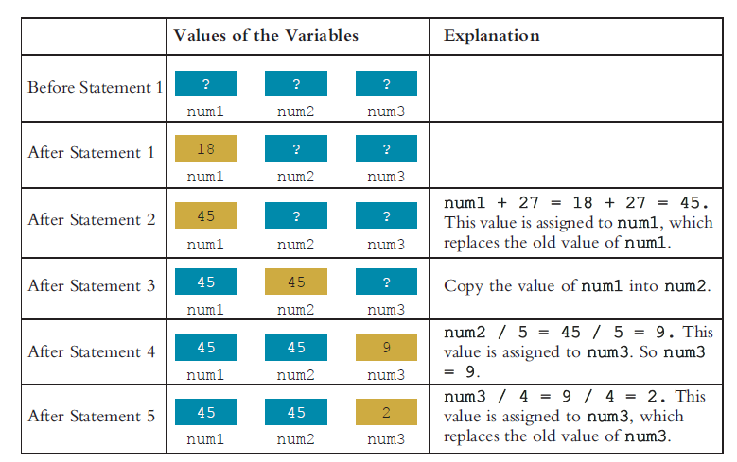

Slide 5
Declaring & Initializing Variables
Variables can be initialized when declared:
int first=13, second=10;
char ch=' ';
double x=12.6;
All variables must be initialized before they are used
But not necessarily during declaration

Slide 6
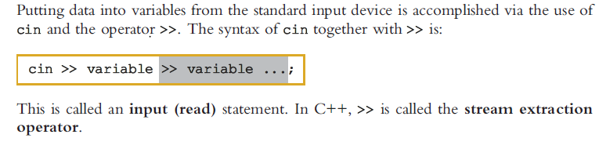
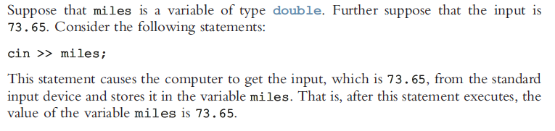
Input Statement

Slide 7
Output
In C++, output on the standard output device is accomplished via the use of cout and the operator <<.
The general syntax of cout together with << is:
This is called an output statement. In C++, << is called the stream insertion operator. Generating output with cout follows two rules:
1. The expression is evaluated, and its value is printed at the current insertion point on the output device.
2. A manipulator is used to format the output. The simplest manipulator is endl

Slide 8
Increment and Decrement Operators
Increment operator(++): increment variable by 1
Pre-increment: ++variable
Post-increment: variable++
int j = i++; // j will contain i, i will be incremented.
int j = ++i; // i will be incremented, and j will contain i+1.
Decrement operator (--): decrement variable by 1
Pre-decrement: --variable
Post-decrement: variable—
What is the difference between the following?
x = 5;
y = ++x;
x = 5;
y = x++;
Notes:
Write a program to find the difference between post & pree operators.
y = ++x; // y==6, x==6 y = x++; // y==5, x==6

Slide 9
More on Assignment Statements
C++ has special assignment statements called compound assignments
+=, -=, *=, /=, and %=
Example:
x=x*y; as
x *= y;

Slide 10
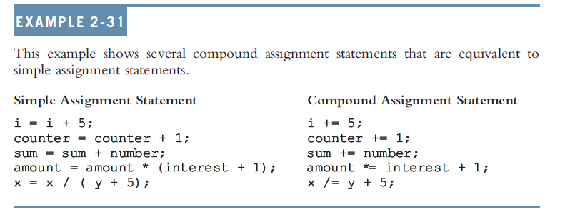
Example

Slide 11
Decision Making: Equality and Relational Operators
if structure
Decision based on truth or false of condition
If condition met, body executed
Else, body not executed
Equality and relational operators
Equality operators
Same level of precedence
Relational operators
Same level of precedence
Associate left to right

Slide 12
Decision Making: Equality and Relational Operators

Slide 13
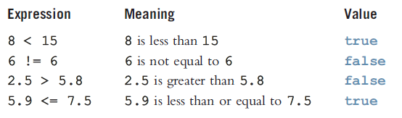
Relational Operators and Simple Data Types

Slide 14
Precedence
Operators Precedence
() highest (applied first)
* / %
+ -
< <= > >=
== !=
= lowest (applied last)

Slide 15
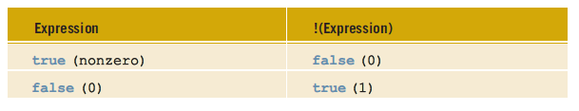
Logical (Boolean) Operators and Logical Expressions
Operator | Description
! | NOT
&& | AND
|| | OR

Slide 16

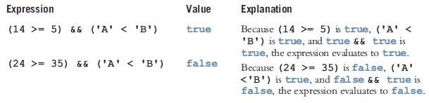
Conti…
AND & OR operators work just like AND/OR-Gate as you studied in Physics in intermediate.
AND = True iff all conditions are TRUE
OR = False iff all results are FASLE

Slide 17
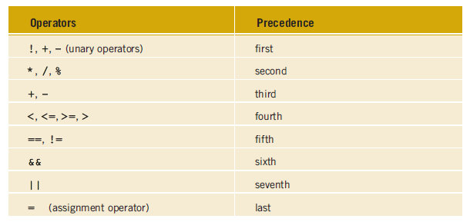
Order of precedence

Slide 18
Another Programming Example
2 // Using if statements, relational
3 // operators, and equality operators.
4 #include <iostream>
5
6 using std::cout; // program uses cout
7 using std::cin; // program uses cin
8 using std::endl; // program uses endl
9
10 // function main begins program execution
11 int main()
12 {
13 int num1; // first number to be read from user
14 int num2; // second number to be read from user
15
16 cout << "Enter two integers, and I will tell you\n"
17 << "the relationships they satisfy: ";

Slide 19
18 cin >> num1 >> num2; // read two integers
19
20 if ( num1 == num2 )
21 cout << num1 << " is equal to " << num2 << endl;
22
23 if ( num1 != num2 )
24 cout << num1 << " is not equal to " << num2 << endl;
25

Slide 20
26 if ( num1 < num2 )
27 cout << num1 << " is less than " << num2 << endl;
28
29 if ( num1 > num2 )
30 cout << num1 << " is greater than " << num2 << endl;
31
32 if ( num1 <= num2 )
33 cout << num1 << " is less than or equal to "
34 << num2 << endl;
35
36 if ( num1 >= num2 )
37 cout << num1 << " is greater than or equal to "
38 << num2 << endl;
39

Slide 21
40 return 0; // indicate that program ended successfully
41
42 } // end function main

Slide 22
Enter two integers, and I will tell you
the relationships they satisfy: 22 12
22 is not equal to 12
22 is greater than 12
22 is greater than or equal to 12

